Slide 1
Finite State Verification
CSE 4495 - Lecture 9 - 10/09/2022
Instructor : Md. Mohaiminul Islam

Slide 2
So, You Want to Perform Verification...
You have a requirement the program must obey.
Great! Let’s write some tests!
Does testing guarantee the requirement is met?
Not quite…
Testing can only make a statistical argument.

Slide 3
What About a Model?
We have previously used models to create tests.
Models are simpler than the real program.
By abstracting away unnecessary details, we can learn important insights.
Models can be used to verify full programs.
Can see if properties hold exhaustively over a model.

Slide 4
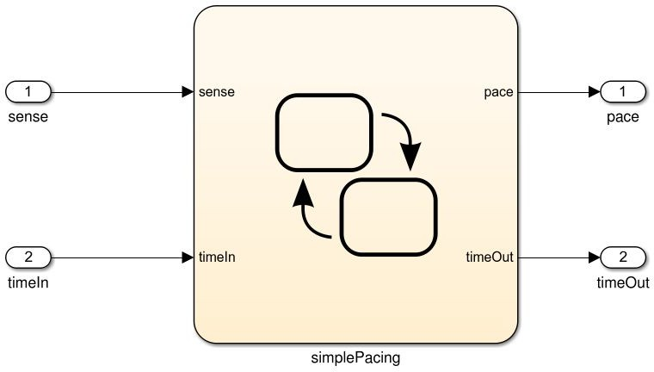

What Can We Do With This Model?
public static void Main(){
System.out.println(“Hell o world!”);
}
Specification
And If the model is
well-formed, consistent, and complete.
And If the model accurately represents the program.
If the model satisfies the specification...
If we can show that the model satisfies the requirement, then the program should as well.

Slide 5
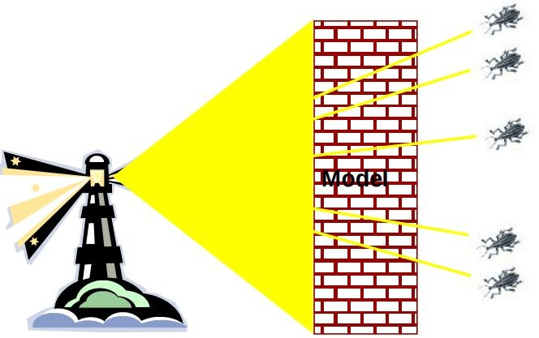
Finite State Verification
Express requirements as Boolean formulae.
Exhaustively search state space of the model for violations of those properties.
If the property holds - proof of correctness
Contrast with testing - no violation might mean bad tests.

Slide 6
Today’s Goals
Formulating requirements as logical expressions.
Introduction to temporal logic.
Building behavioral models in NuSMV.
Performing finite-state verification over the model.
Exhaustive search algorithms.

Slide 7
Expressing Requirements in Temporal Logic

Slide 8
Expressing Properties
Properties expressed in a formal logic.
Temporal logic ensures that properties hold over execution paths, not just at a single point in time.
Safety Properties
System never reaches bad state.
Always in some good state.
“If the traffic light is red, it will always turn green within 10 seconds.”
“If an emergency vehicle arrives at a red light, it must turn green in the next time step.”

Slide 9
Expressing Properties
Liveness Properties
Eventually useful things happen.
Fairness criteria.
Reason over paths of unknown length.
“If the light is red, it must eventually become green.”
“If the package is shipped, it must eventually arrive.”
“If Player A is taking a turn, Player B must be allowed a turn at some time in the future.”

Slide 10
Temporal Logic
Represents propositions qualified over time.
Linear Time Logic (LTL)
Reason about events over a single timeline.
Computation Tree Logic (CTL)
Branching logic that can reason about multiple timelines.
Each can express properties that the other cannot.

Slide 11
Linear Time Logic Formulae
Formulae written with boolean predicates, logical operators (and, or, not, implication), and operators:
hunger = “I am hungry” burger = “I eat a burger”
X (next) | X hunger | In the next state, I will be hungry.
G (globally) | G hunger | In all future states, I will be hungry.
F (finally) | F hunger | Eventually, there will be a state where I am hungry.
U (until) | hunger U burger | I will be hungry until I start to eat a burger. (hunger does not need to be true once burger becomes true)
R (release) | hunger R burger | I will cease to be hungry after I eat a burger. (hunger and burger are true at the same time for at least one state before hunger becomes false)

Slide 12
LTL Examples
X (next) - This operator provides a constraint on the next moment in time.
(sad && !rich) -> X(sad)
(hungry && haveMoney) -> X(orderedPizza)
F (finally) - At some point in the future, this property will be true.
(funny && ownCamera) -> F(famous)
sad -> F(happy)
send -> F(receive)

Slide 13
LTL Examples
G (globally) - This property must be true forever.
winLottery -> G(rich)
U (until) - One property must be true until the second becomes true.
startLecture -> (talk U endLecture)
born -> (alive U dead)
request -> (!reply U acknowledgement)

Slide 14
More LTL Examples
G (requested -> F (received))
G (received -> X (processed))
G (processed -> F (G (done)))
If all three above are true, can this be true?
G (requested -> G (!done))
requested = action requested received = request received processed = request processed done = action completed

Slide 15
Computation Tree Logic Formulae
Combines all-path quantifiers with path-specific quantifiers:
A (all) | A hunger | Starting from the current state, I must be hungry on all paths.
E (exists) | E hunger | There must be some path, starting from the current state, where I am hungry.
X (next) | X hunger | In the next state on this path, I will be hungry.
G (globally) | G hunger | In all future states on this path, I will be hungry.
F (finally) | F hunger | Eventually on this path, there will be a state where I am hungry.
U (until) | hunger U burger | On this path, I will be hungry until I start to eat a burger. (I must eventually eat a burger)
W (weak until) | hunger W burger | On this path, I will be hungry until I start to eat a burger. (There is no guarantee that I eat a burger)

Slide 16
CTL Examples
coffee= “I like coffee.” warm = “It is warm.”
AG coffee
EF coffee
AF (EG coffee)
EG (AF coffee)
AG (coffee U warm)
EF ((EX coffee) U (AG warm))

Slide 17
Examples
requested: a request has been made
acknowledged: request has been acknowledged.
CTL: AG (requested -> AF acknowledged)
On all paths (A) from an initial state, at every state in the path (G), if requested holds true, then (->) for all paths (A) from that state, eventually (F) at some other state, acknowledge holds true.
LTL: G (requested -> F acknowledged)
On all paths from an initial state, at every state in the path (G), if requested holds true, then (->) eventually (F) at some other state, acknowledge holds true.

Slide 18

Examples
It is always possible (AG) to reach a state (EF) where we can reset.
AG (EF reset)
Is LTL formula G (F reset) the same expression?
Eventually (F), the system will reach a state where P will be true forever (G).
F (G P)
Is CTL formula AF (AG P) the same?

Slide 19
Building Models

Slide 20
Building Models
Many different modeling languages.
Most verification tools use their own language.
Most map to finite state machines.
Define list of variables.
Describe how values are calculated.
Each “time step”, recalculate values of these variables.
State is the current values of all variables.

Slide 21
Building Models in NuSMV
NuSMV is a symbolic model checker.
Models written in a basic language, represented using Binary Decision Diagrams (BDDs).
BDDs translate concrete states into compact summary states.
Allows large models to be processed efficiently.
Properties may be expressed in CTL or LTL.
If a model may be falsified, it provides a concrete counterexample demonstrating how it was falsified.

Slide 22
A Basic NuSMV Model
MODULE VAR
request: boolean; status: {ready, busy};
main | Models consist of one or more modules, which execute in parallel.
The state of the model is the current value of all variables.
ASSIGN
Expressions define how the state of each variable can change.
init(status) := ready; next(status) :=
case
“request” is set randomly. This represents an environmental factor out of our control.
status=ready & request: busy; status=ready & !request : ready; TRUE: {ready, busy};
esac;
SPEC AG(request -> AF (status = busy))
Property we wish to prove over the model.

Slide 23
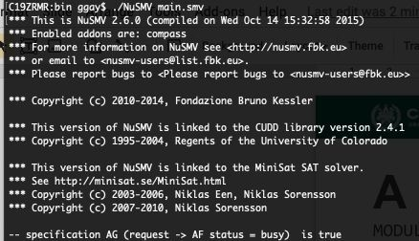
Checking Properties
Execute from command line:
NuSVM <model name>
Properties that are true are indicated as true.
If property is false, a counter-example is shown (input violating the property).

Slide 24
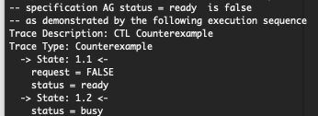
Checking Properties
New property: AG (status = ready)
(Obviously not true -
we set it randomly in the absence of a request)
Counterexample:
In first state, request = false, status = ready.
We set status randomly for second state (because request was false). It is set to busy, violating property.

Slide 25
MODULE main VAR
init(ped_light) := WAIT; next(ped_light) := case
ped_light=WAIT &
traffic_light=RED: WALK; ped_light=WAIT: WAIT; ped_light=WALK: {WALK,FLASH}; ped_light=FLASH: {FLASH, WAIT}; TRUE: {WAIT};
esac;
next(button) := case
button=SET & ped_light=WALK: RESET; button=SET: SET;
button=RESET & traffic_light=GREEN:
{RESET,SET};
button=RESET: RESET; TRUE: {RESET};
esac;
traffic_light: {RED, YELLOW, GREEN}; ped_light: {WAIT, WALK, FLASH}; button: {RESET, SET};
ASSIGN
init(traffic_light) := RED; next(traffic_light) := case
traffic_light=RED & button=RESET:
GREEN;
traffic_light=RED: RED;
traffic_light=GREEN & button=SET:
{GREEN,YELLOW};
traffic_light=GREEN: GREEN; traffic_light=YELLOW:
{YELLOW, RED};
TRUE: {RED};
esac;

Slide 26
Describe a safety property (something does or does not happen at a specific time) and formulate in CTL.
Describe a liveness property (something eventually happens) and formulate in LTL.
MODULE main VAR
init(ped_light) := WAIT; next(ped_light) := case
ped_light=WAIT &
traffic_light=RED: WALK; ped_light=WAIT: WAIT; ped_light=WALK: {WALK,FLASH}; ped_light=FLASH: {FLASH, WAIT}; TRUE: {WAIT};
esac;
next(button) := case
button=SET & ped_light=WALK: RESET; button=SET: SET;
button=RESET & traffic_light=GREEN:
{RESET,SET};
button=RESET: RESET; TRUE: {RESET};
esac;
traffic_light: {RED, YELLOW, GREEN}; ped_light: {WAIT, WALK, FLASH}; button: {RESET, SET};
ASSIGN
init(traffic_light) := RED; next(traffic_light) := case
traffic_light=RED & button=RESET:
GREEN;
traffic_light=RED: RED;
traffic_light=GREEN & button=SET:
{GREEN,YELLOW};
traffic_light=GREEN: GREEN; traffic_light=YELLOW:
{YELLOW, RED};
TRUE: {RED};
esac;

Slide 27
Solution

Slide 28
Activity - Potential Solutions
Safety Property
A bad thing never happens, or a good thing happens at a specific time.
AG (pedestrian_light = walk ->
traffic_light != green)
The pedestrian light cannot indicate that I should walk when the traffic light is green.
This is a safety property. We are saying that this should
NEVER happen.

Slide 29
Activity - Potential Solutions
Liveness Property
Eventually useful things happen.
G (traffic_light = RED & button = RESET
-> F (traffic_light = green))
If the light is red, and the button is reset, then eventually, the light will turn green.
This is a liveness property, as we assert that something will eventually happen.

Slide 30
Proving Properties Over Models

Slide 31
Proving Properties
Search state space for property violations.
Violations give us counter-examples
Path that demonstrates the violation.
(useful test case)
Implications of counter-example:
Property is incorrect.
Model does not reflect expected behavior.
Real issue found in the system being designed.

Slide 32
Test Generation from FS Verification
We can also take properties and negate them.
Called a “trap property” - we assert that a property can never be met.
Shows one way the property can be met.
Can be used as a test for the real system.
Demonstrate that final system meets specification.

Slide 33
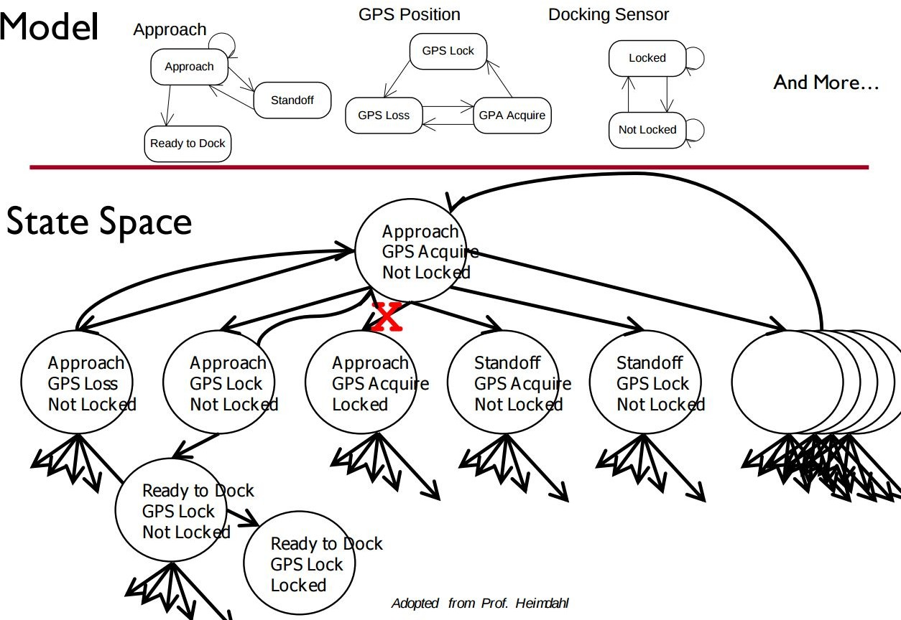
Exhaustive Search
Algorithms examine all execution paths through the state space.
Major limitation - state space explosion.
Limit number of variables and possible values to control state space size.

Slide 34
Search Based on SAT
Express properties in conjunctive normal form:
f = (!x2 || x5) && (x1 || !x3 || x4) && (x4 || ! x5) && (x1|| x2)
Examine reachable states and choose a transition
based on how it affects the CNF expression.
If we want x2 to be false, choose a transition that imposes that change.
Continue until CNF expression is satisfied.

Slide 35
Boolean Satisfiability (SAT)
Find assignments to Boolean variables X₁,X₂,...,X_{n} that results in expression φ evaluating to true.
Defined over expressions written in conjunctive normal form.
φ = (X₁ ∨ ￢X₂) ∧ (￢X₁ ∨ X₂)
(X₁ ∨ ￢X₂) is a clause, made of variables, ￢, ∨
Clauses are joined with ∧

Slide 36
Boolean Satisfiability
Find assignment to X₁,X₂,X₃,X₄,X₅ to solve
(￢X₂ ∨ X₅) ∧ (X₁ ∨￢X₃ ∨ X₄) ∧ (X₄ ∨ ￢X₅) ∧ (X₁ ∨
X₂)
One solution: 1, 0, 1, 1, 1
(￢X₂ ∨ X₅) ∧ (X₁ ∨￢X₃ ∨ X₄) ∧ (X₄ ∨ ￢X₅) ∧ (X₁ ∨
X₂)
(￢0 ∨ 1) ∧ (1 ∨￢1 ∨1) ∧ (1 ∨ ￢1) ∧ (1 ∨ 0)
(1) ∧ (1) ∧ (1) ∧ (1)
1

Slide 37
Branch & Bound Algorithm
Set variable to true or false.
Apply that value.
Does value satisfy the clauses that it appears in?
If so, assign a value to the next variable.
If not, backtrack (bound) and apply the other value.
Prunes branches of the boolean decision tree as values are applied.

Slide 38
Branch & Bound Algorithm
φ = (￢x2 ∨ x5) ∧ (x1 ∨ ￢x3 ∨ x4) ∧ (x4 ∨ ￢x5) ∧ (x1 ∨
x2)
Set x1 to false.
φ = (￢x2 ∨ x5) ∧ (0 ∨ ￢x3 ∨ x4) ∧ (x4 ∨ ￢x5) ∧ (0 ∨
x2)
Set x2 to false.
φ = (1 ∨ x5) ∧ (0 ∨ ￢x3 ∨ x4) ∧ (x4 ∨ ￢x5) ∧ (0 ∨ 0)
Backtrack and set x2 to true.
φ = (0 ∨ x5) ∧ (0 ∨ ￢x3 ∨ x4) ∧ (x4 ∨ ￢x5) ∧ (0 ∨ 1)

Slide 39
DPLL Algorithm
Set a variable to true/false.
Apply that value to the expression.
Remove all satisfied clauses.
If assignment does not satisfy a clause, then remove that variable from that clause.
If this leaves any unit clauses (single variable clauses),
assign a value that removes those next.
Repeat until a solution is found.

Slide 40
DPLL Algorithm
φ = (￢x2 ∨ x5) ∧ (x1 ∨ ￢x3 ∨ x4) ∧ (x4 ∨ ￢x5) ∧ (x1 ∨
x2)
Set x2 to false.
φ = (￢0 ∨ x5) ∧ (x1 ∨ ￢x3 ∨ x4) ∧ (x4 ∨ ￢x5) ∧ (x1 ∨ 0) φ = (x1 ∨ ￢x3 ∨ x4) ∧ (x4 ∨ ￢x5) ∧ (x1)
Set x1 to true.
φ = (1 ∨ ￢x3 ∨ x4) ∧ (x4 ∨ ￢x5) ∧ (1) φ = (x4 ∨ ￢x5)
Set x4 to false, then x5 to false.
φ = (0 ∨ ￢x5) φ = (￢0)

Slide 41
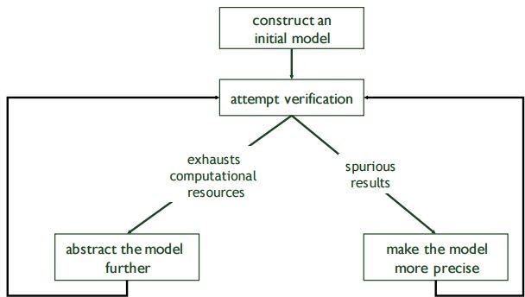
Model Refinement
Must balance precision with efficiency.
Models that are too simple introduce failure paths that may not be in the real system.
Complex models may be infeasible due to resource exhaustion.

Slide 42
Who Uses This Stuff?
Used heavily in safety-critical development.
Verifies certain complex, critical functions.
Used extensively in automotive, aerospace, medical development domains.
Used to verify security policies, stateful behaviors.
Uses at Amazon Web Services to verify cloud security.
Not used for all functionality.
Time-consuming, requires additional effort.

Slide 43
We Have Learned
We can perform verification by creating models of function behavior and proving that the requirements hold over the model.
To do so, express requirements as logical formulae written in a temporal logic.
Finite state verification exhaustively searches the state
space for violations of properties.
Presents counter-examples showing properties are violated.

Slide 44
We Have Learned
By performing this process, we can gain confidence that the system will meet the specifications.
Can also generate test cases to demonstrate that properties hold over the final system.
Negate a property, the counter-example shows that the property can be met.
Execute the input from the counter-example on the real system - should give the same result!

Slide 45
Next Time
Exercise Session: Finite-State Verification
2018-08-27
Chalmers University of Technology
46

Slide 46
Thank You

